Slide 1

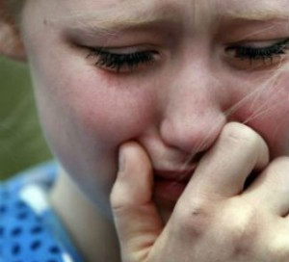
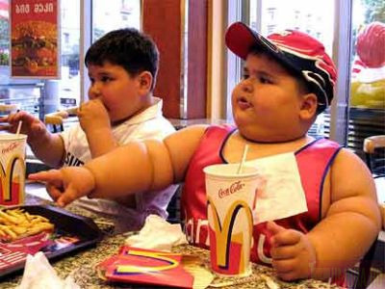

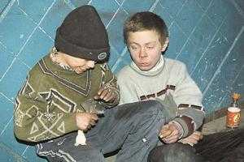

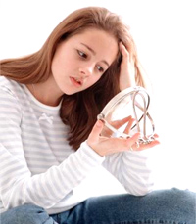

What are their problems?

Slide 2
ANY PROBLEMS?
CAN I HEIP YOU?

Slide 3
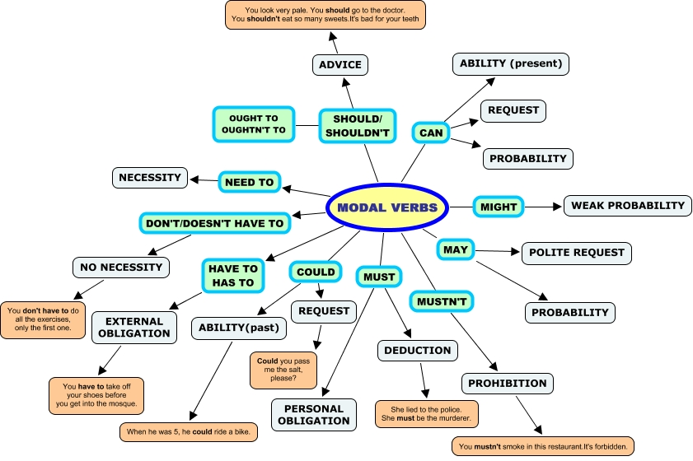

Slide 4
Define the functions of the modal verbs.
What verbs express:
possibility?
probability?
necessity?
ability?
obligation?
advice?
prohibition?

Slide 5
Key:
Possibility-might, may, can
Probability-should, must
Necessity-need to, must
Obligation-have to, has to, must
Advice-should
Prohibition-mustn’t, don’t need
Ability-can, could (past)
Request- can, could, should

Slide 6
If you are asked to describe a photo or a picture in the exam, here is some language you can use:
What is in the picture?
In the picture I can see ... There’s / There are ... There isn’t a ... / There aren’t any ...
Say what is happening with the present continuous
The man is ...ing The people are ...ing It’s raining.
Where in the picture?
At the top/bottom of the picture ... In the middle of the picture ... On the left/right of the picture ... next to in front of behind near on top of under
If something isn’t clear
It looks like a ... It might be a ... He could be ...ing Maybe it’s a ...

Slide 7
Ex10 p 89 Key:
1 don’t have to come
2 didn’t need to
3 must have left
4 can’t have stolen
5 should have arrived

Slide 8
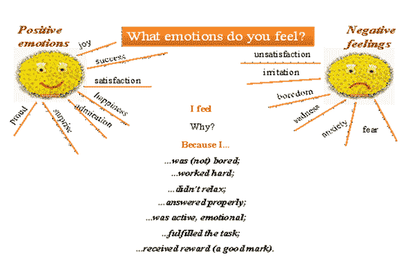
How do you feel? Any Problems?

Slide 9
Hometask
Ex 2,3 p38 Workbook

Slide 10


Don’t Worry!
Be Happy!!

